Slide 1
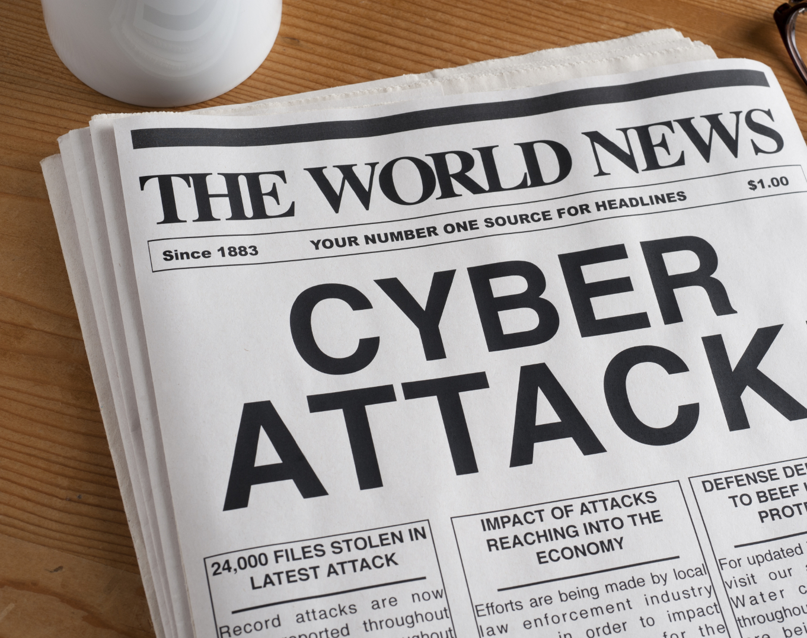
Cyber Minutes Weekly
“Harvested"
11-22-2023 | Jonathan Montoya

Slide 2

The Big One
JP Morgan Corporate Challenge website and VPN credentials were compromised leading to a network breach
Hackers stole the PII of 76 million household and 7 million small business accounts
Around 60% of U.S. households were affected by this breach
JP Morgan was only one of the 13 financial institutions to be breached in 2014
Verizon breach report stated that 78% of all cyber espionage malware are deployed from email attachments

Slide 3
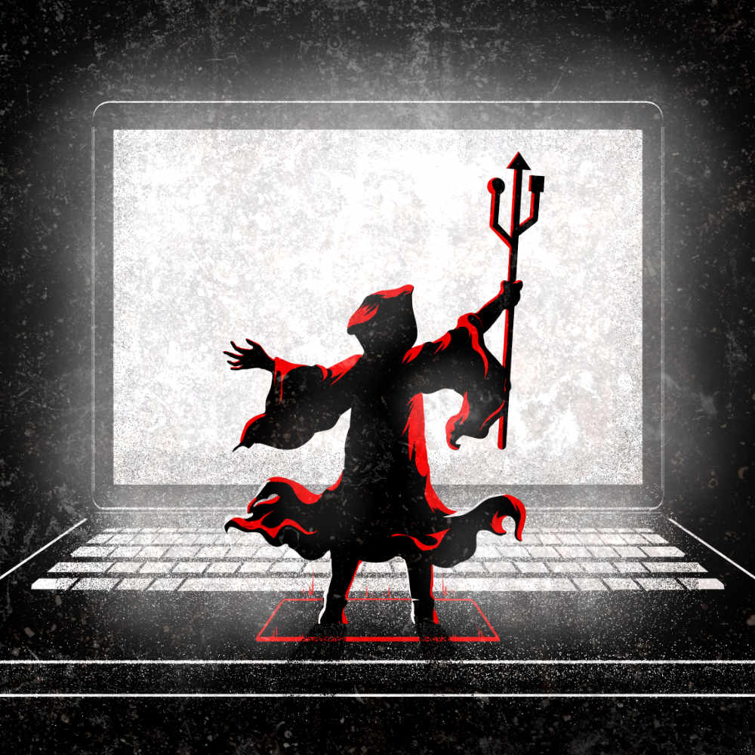
Race for Credentials
Employee’s personal computer was infected with malware which compromised the credentials to VPN
Simmco Data Systems was breached allowing attackers access to the website used to register for a corporate sponsored charity race
Hackers obtained access to the internal network and was able to escalate privileges and take C2 of 90 servers through use of zero-day vulnerabilities
The attackers worked within the network from April-August 2014 quietly exfiltrating data over this period of time

Slide 4
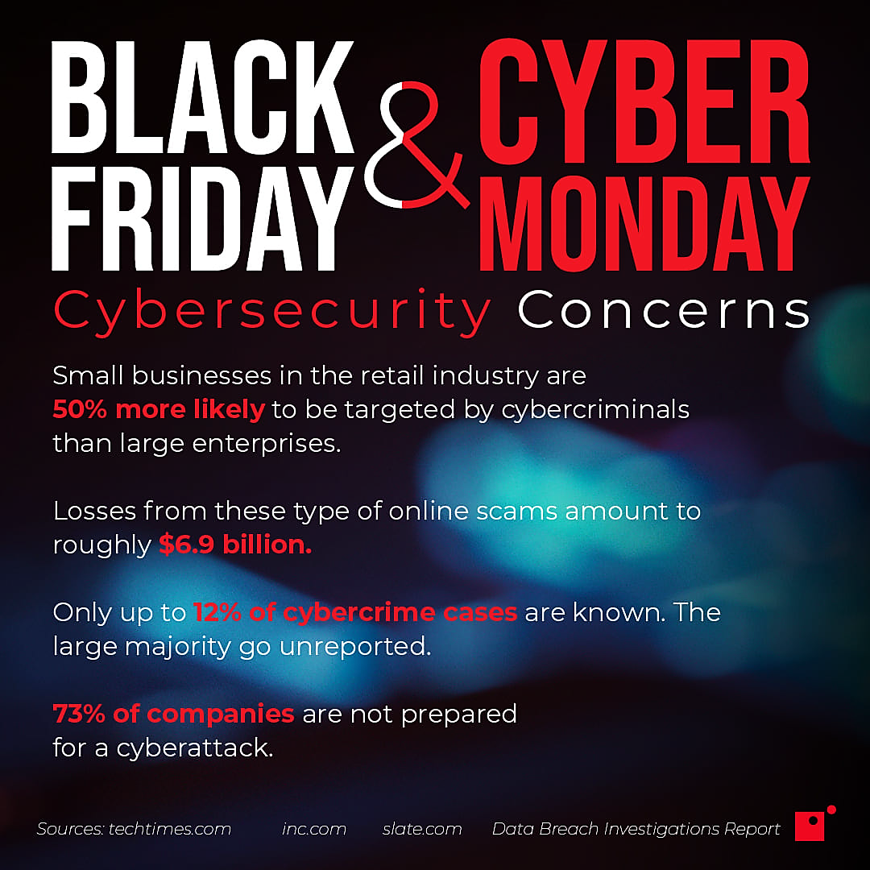
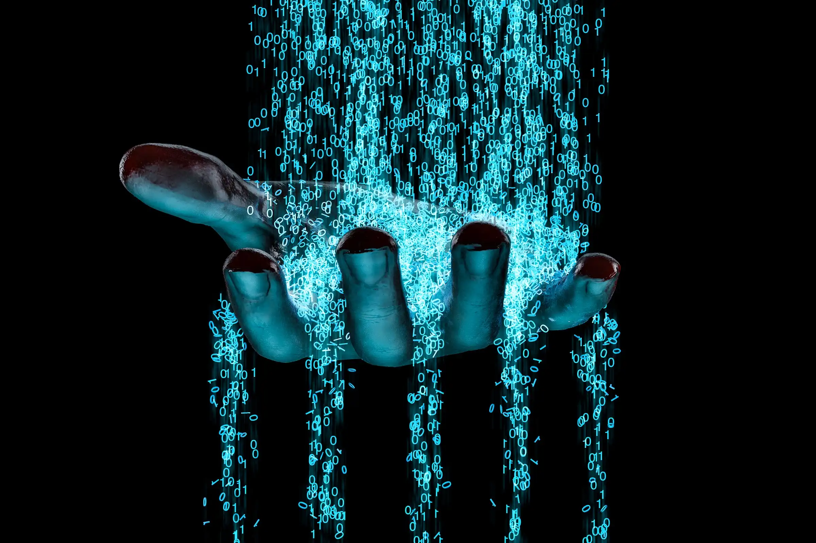

Slide 5
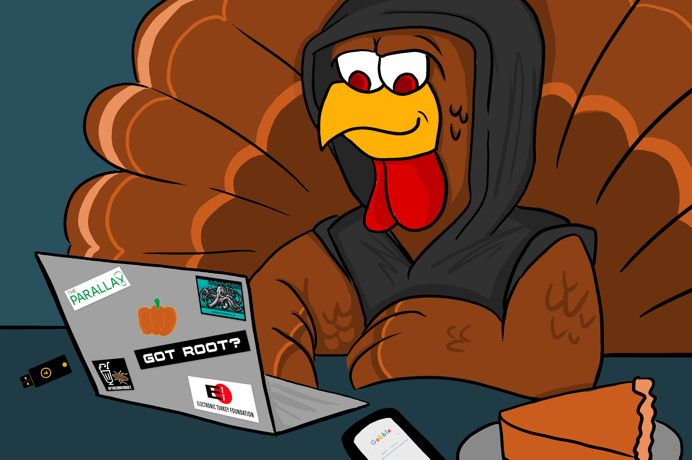
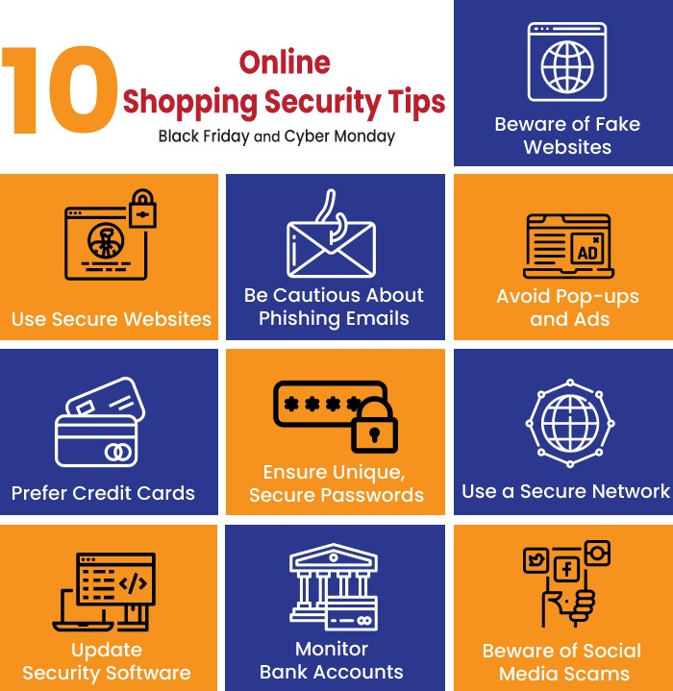
Happy Thanksgiving

Slide 6
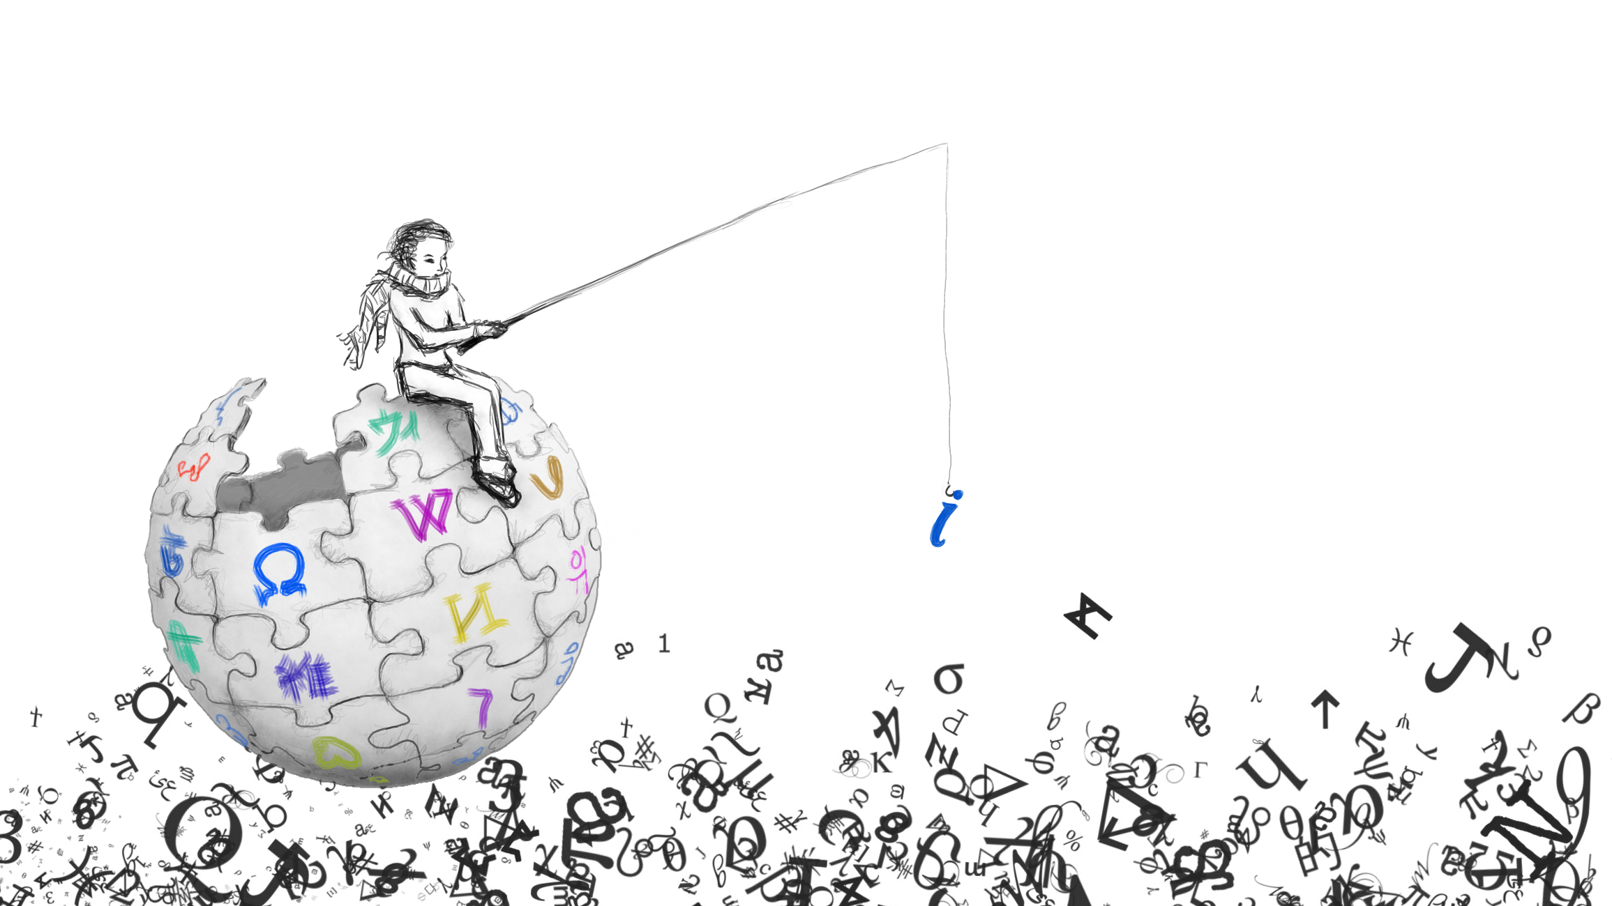
Sources
https://darknetdiaries.com/transcript/76/
https://www.giac.org/paper/gsec/36190/minimizing-damage-jp-morgans-data-breach/143120
https://www.bloomberg.com/news/articles/2014-08-29/jpmorgan-hack-said-to-span-months-via-multiple-flaws#xj4y7vzkg
https://www.wired.com/insights/2014/10/a-silver-lining-in-the-jp-morgan-breach-3/
https://darknetdiaries.com/artwork/
https://www.impactmybiz.com/blog/blog-why-cybersecurity-vital-black-friday-cyber-monday/
https://www.stealthlabs.com/blog/top-10-cyber-security-tips-for-black-friday-and-cyber-monday/

